Slide 1
THE LIFE OF CHRIST

Slide 2
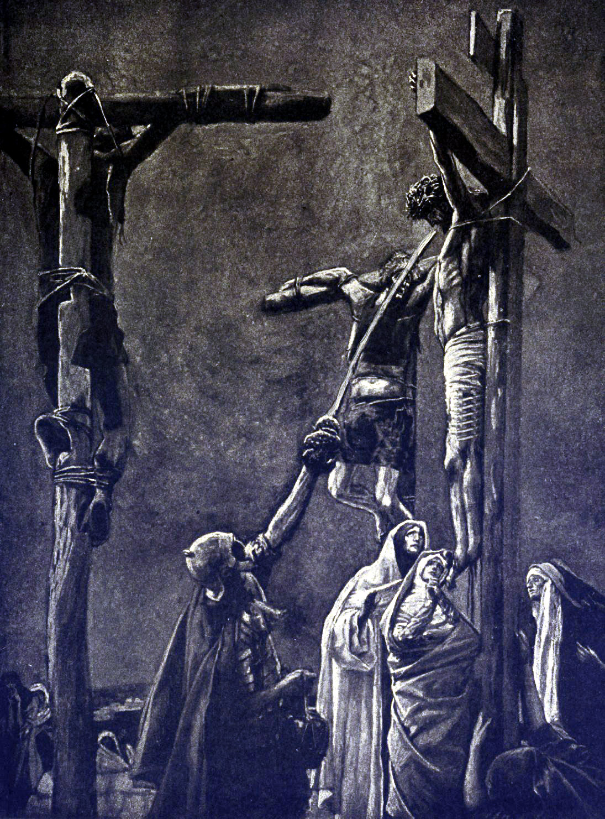
John 19:28 After this, Jesus, knowing that all things were now accomplished, that the Scripture might be fulfilled, said, "I thirst!" ²⁹ Now a vessel full of sour wine was sitting there; and they filled a sponge with sour wine, put it on hyssop, and put it to His mouth.

Slide 3
Psalm 22:15 My strength is dried up like a potsherd, And My tongue clings to My jaws; You have brought Me to the dust of death.
Psalm 69:21 They also gave me gall for my food, And for my thirst they gave me vinegar to drink.

Slide 4
Hyssop is a species of marjoram and a member of the mint family. Hyssop was an aromatic shrub under one meter (three feet) tall with clusters of yellow flowers. It grew in rocky crevices and was cultivated on terraced walls. … (1 Kin.4:33). Bunches of hyssop were used to sprinkle blood on the doorposts in Egypt (Ex. 12:22), and in purification ceremonies (Lev. 14:4, 6, 51-52). David mentioned it as an instrument of inner cleansing (Ps. 51:7) (Nelson’s New Illustrated Bible Dictionary p. 1005).

Slide 5
Both Matthew and Mark call it a reed (Mt. 27:48; Mk. 15:36), but John tells us what kind of reed it was.

Slide 6
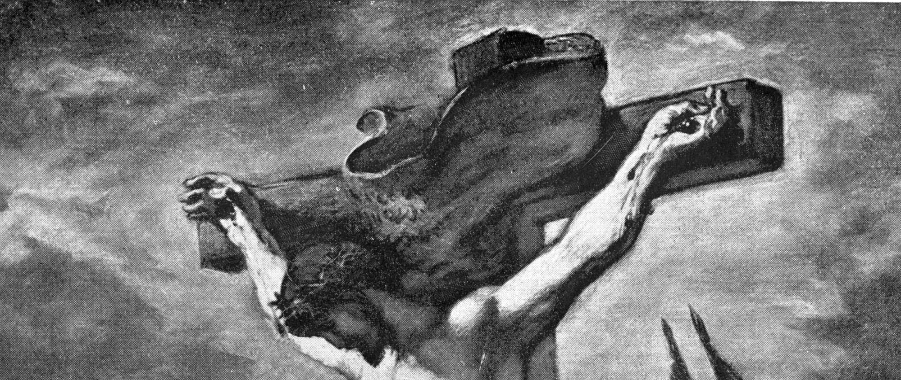
John 19:30 So when Jesus had received the sour wine, He said, "It is finished!" And bowing His head, He gave up His spirit.

Slide 7
Luke 24:44 "These are the words which I spoke to you while I was still with you, that all things must be fulfilled which were written in the Law of Moses and the Prophets and the Psalms concerning Me." 45 And He opened their understanding, that they might comprehend the Scriptures. 46 Then He said to them, "Thus it is written, and thus it was necessary for the Christ to suffer and to rise from the dead the third day, 47 "and that repentance and remission of sins should be preached in His name to all nations, beginning at Jerusalem. 48 "And you are witnesses of these things.

Slide 8
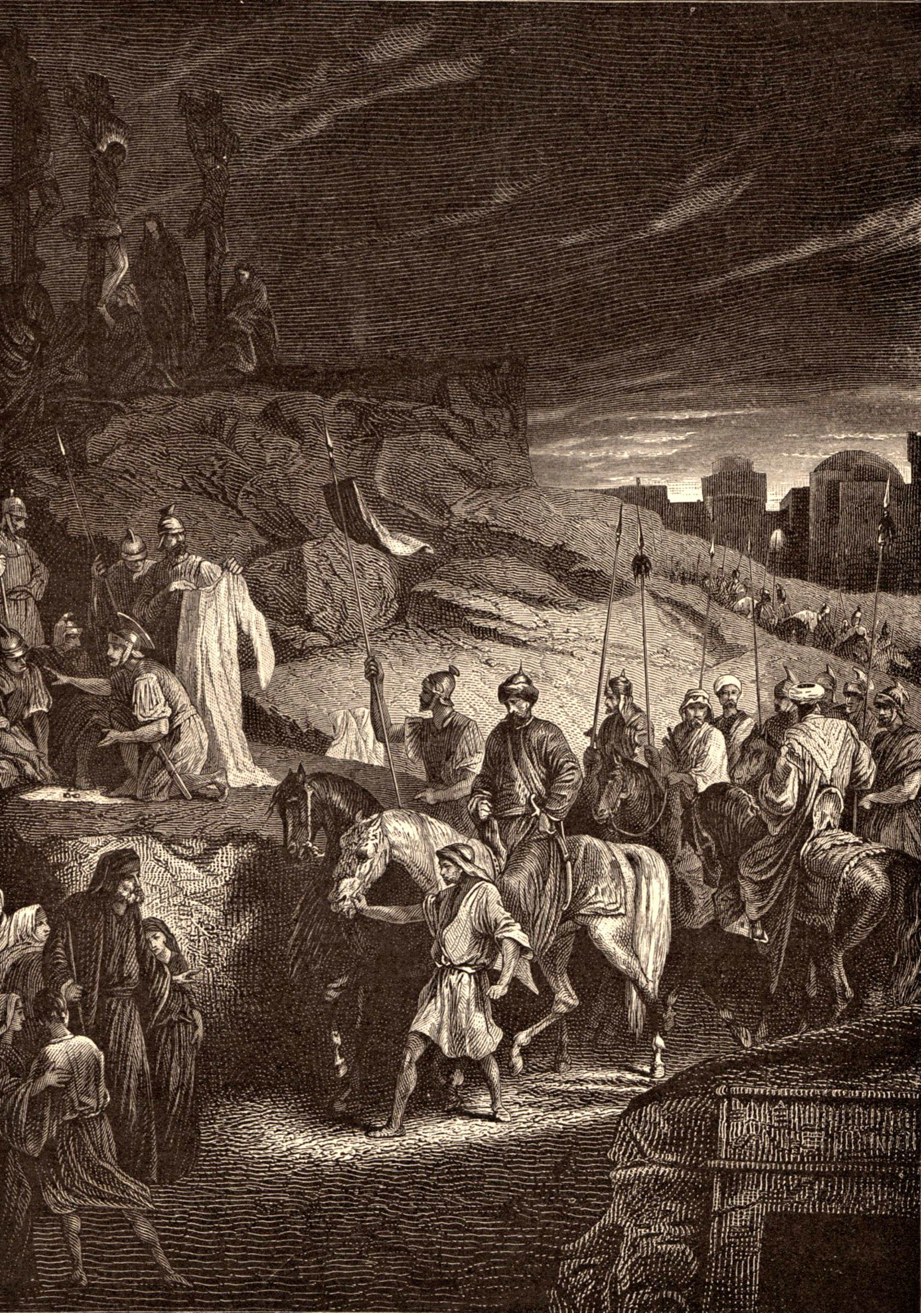
Luke 23: ⁴⁶ And when Jesus had cried out with a loud voice, He said, "Father, 'into Your hands I commit My spirit.' " Having said this, He breathed His last.

Slide 9
John 10:17 "Therefore My Father loves Me, because I lay down My life that I may take it again. ¹⁸ "No one takes it from Me, but I lay it down of Myself. I have power to lay it down, and I have power to take it again. This command I have received from My Father."

Slide 10
John 14:1 "Let not your heart be troubled; you believe in God, believe also in Me. ² "In My Father's house are many mansions; if it were not so, I would have told you. I go to prepare a place for you. ³ "And if I go and prepare a place for you, I will come again and receive you to Myself; that where I am, there you may be also.

Slide 11
Matthew 27:51 Then, behold, the veil of the temple was torn in two from top to bottom; and the earth quaked, and the rocks were split, ⁵² and the graves were opened; and many bodies of the saints who had fallen asleep were raised; ⁵³ and coming out of the graves after His resurrection, they went into the holy city and appeared to many. ⁵⁴ So when the centurion and those with him, who were guarding Jesus, saw the earthquake and the things that had happened, they feared greatly, saying, "Truly this was the Son of God!"

Slide 12
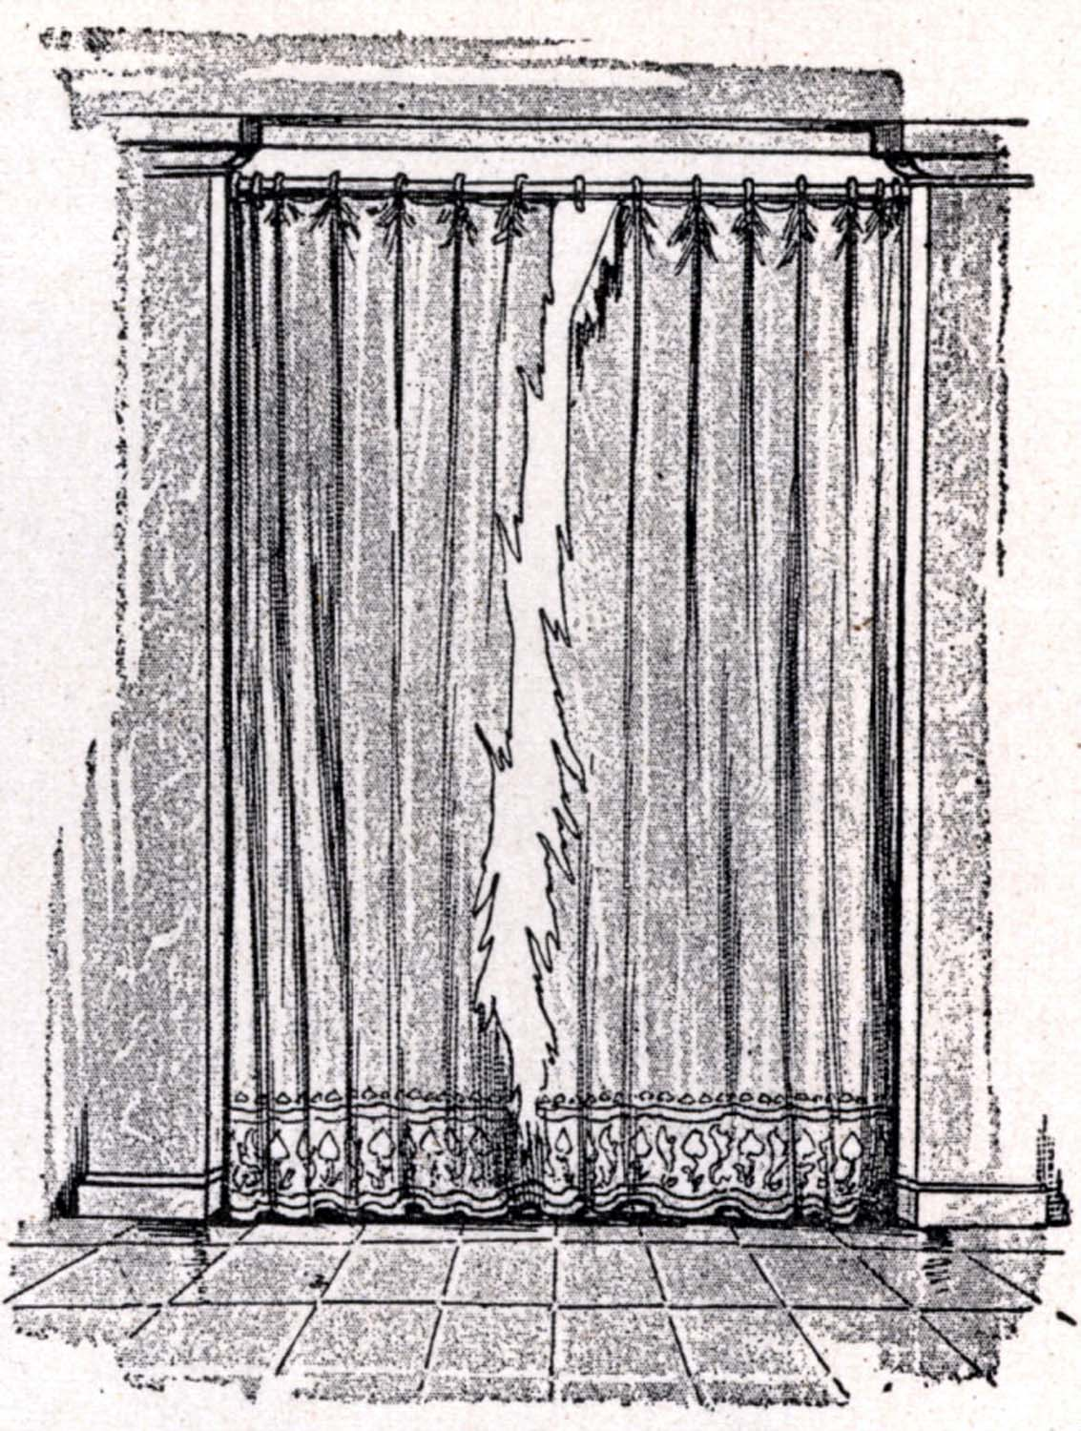

Slide 13
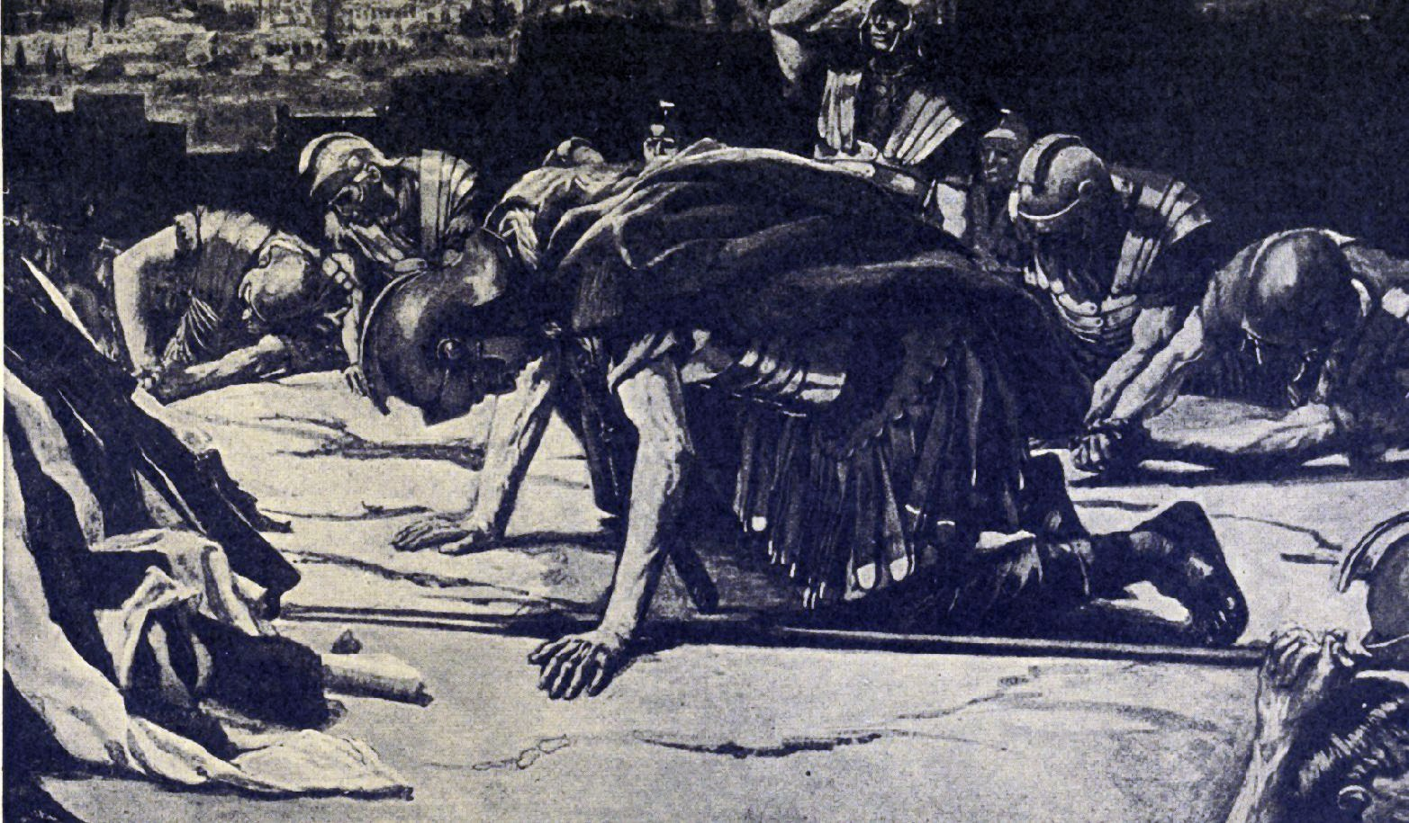
“Certainly this was a righteous man!” (Lk. 23:47).

Slide 14
John 19:31 Therefore, because it was the Preparation Day, that the bodies should not remain on the cross on the Sabbath (for that Sabbath was a high day), the Jews asked Pilate that their legs might be broken, and that they might be taken away. ³² Then the soldiers came and broke the legs of the first and of the other who was crucified with Him. ³³ But when they came to Jesus and saw that He was already dead, they did not break His legs.

Slide 15
³⁴ But one of the soldiers pierced His side with a spear, and immediately blood and water came out. ³⁵ And he who has seen has testified, and his testimony is true; and he knows that he is telling the truth, so that you may believe. ³⁶ For these things were done that the Scripture should be fulfilled, "Not one of His bones shall be broken." ³⁷ And again another Scripture says, "They shall look on Him whom they pierced."

Slide 16
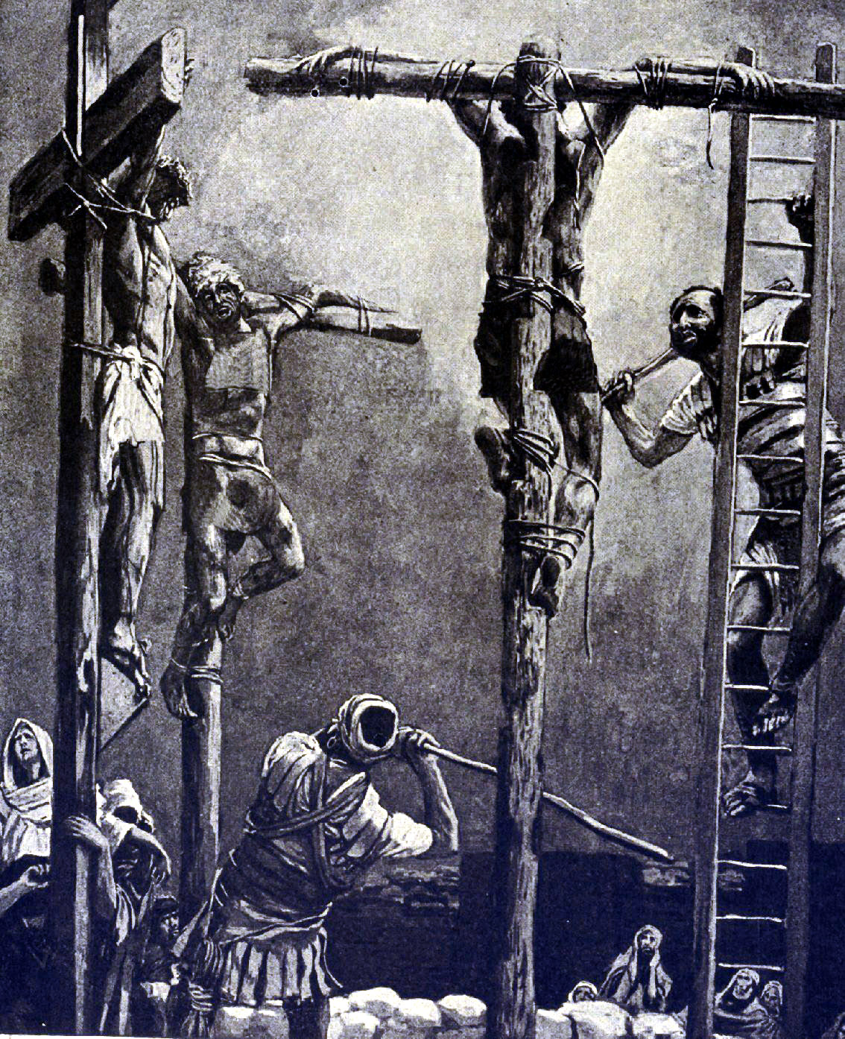
They broke the two thieves’ legs first, but when they got to Jesus, He was already dead, so they did not break His legs. Just as the Passover lamb’s bones were not to be broken (Num. 9:12), neither was Jesus’ bones broken because He is our Passover (1 Cor. 5:7). Once again, this fulfilled a prophecy about Jesus (Ps. 34:20).

Slide 17
There are two possibilities that could produce what looked like water and blood.
1. It is possible they pierced His bladder, which would cause urine and blood to flow out. While this would produce the effect of water and blood it seems unlikely he pierced His bladder since he would have to pierce Him with a downward motion, which would have been difficult with Jesus being elevated on the cross.
2. Others believe he pierced Him through the ribs and broke the lining around the wall of the heart.

Slide 18
Mr. Halley notes:
Some medical authorities have said that in the case of heart rupture, and in that case only, the blood collects in the pericardium, the lining around the wall of the heart, and divides into a sort of bloody clot and a watery serum. If this is a fact, then the actual immediate physical cause of Jesus' death was heart rupture. Under intense pain, and the pressure of his wildly raging blood, his heart burst open (Halley's Bible Handbook, p.549).

Slide 19
This watery fluid that would have come out of the wound first could have been a combination of serous pleural which is found in the membrane around the lungs, and pericardial fluid, which is secreted by the serous membrane on the pericardious sac on the outside of the heart (http://en.wikipedia.org/wiki/Pericardial_fluid).

Slide 20
John 19:38 After this, Joseph of Arimathea, being a disciple of Jesus, but secretly, for fear of the Jews, asked Pilate that he might take away the body of Jesus; and Pilate gave him permission. So he came and took the body of Jesus.

Slide 21
We can learn more details about this event by examining the four Gospels (Mt. 27:57ff; Mk. 15:42ff; Lk. 23:50ff; Jn. 19:38ff).

Slide 22
³⁹ And Nicodemus, who at first came to Jesus by night, also came, bringing a mixture of myrrh and aloes, about a hundred pounds. ⁴⁰ Then they took the body of Jesus, and bound it in strips of linen with the spices, as the custom of the Jews is to bury.

Slide 23
Myrrh – An extract from a stiff-branched tree with white flowers and plum-like fruit. After myrrh was extracted from the wood, it soon hardened and was valued as an article of trade. It was used … in anointing oil (Ex. 30:23), and was used as perfume (Ps. 45:8; Prov. 7:17; Song 3:6), in purification rites for women (Esth. 2:12), as a gift for the infant Jesus (Matt. 2:11), and in embalming (John 19:39). According to the Gospel of Mark (15:23), the drink offered to Jesus before His crucifixion was “wine mingled with myrrh.” (Nelson’s New Illustrated Bible Dictionary, p. 2006).

Slide 24
The other accounts say that Jesus was wrapped in fine linen sidon (Mt. 27:59; Mk. 15:46; Lk. 23:53), but John says His body was bound in strips of linen othonion with the spices.

Slide 25
Mr. Gower states:
Exceptionally, a body was covered in spices and in paste, and these were tied to the body by layers of white “roller bandage.” The paste hardened and impregnated the bandages until a hard preservative mound or cocoon was formed about the body (The New Manners & Customs of Bible Times, p.73).

Slide 26
It only mentions the strips of linen othonion and the cloth handkerchief being His grave clothes (Lk. 24:12; Jn. 20:5-7).

Slide 27
⁴¹ Now in the place where He was crucified there was a garden, and in the garden a new tomb in which no one had yet been laid. ⁴² So there they laid Jesus, because of the Jews' Preparation Day, for the tomb was nearby.

Slide 28
“And they made His grave with the wicked -- But with the rich at His death” (Isa. 53:9).

Slide 29
Isaiah 53:9 They intended to bury him with criminals,²⁵ but he ended up in a rich man's tomb

Slide 30
Matthew 27:59 When Joseph had taken the body, he wrapped it in a clean linen cloth, ⁶⁰ and laid it in his new tomb which he had hewn out of the rock; and he rolled a large stone against the door of the tomb, and departed. ⁶¹And Mary Magdalene was there, and the other Mary, sitting opposite the tomb.

Slide 31
While there were other women there (Lk. 23:55), including a woman named Joanna (Lk. 24:10), Matthew only mentions two women named Mary. Not only did they see where the tomb was, they saw how Jesus’ body was laid (Mk. 15:47; Lk. 23:55).

Slide 32
Matthew 27:62 On the next day, which followed the Day of Preparation, the chief priests and Pharisees gathered together to Pilate, ⁶³ saying, "Sir, we remember, while He was still alive, how that deceiver said, 'After three days I will rise.' ⁶⁴ "Therefore command that the tomb be made secure until the third day, lest His disciples come by night and steal Him away, and say to the people, 'He has risen from the dead.' So the last deception will be worse than the first." ⁶⁵ Pilate said to them, "You have a guard; go your way, make it as secure as you know how." ⁶⁶ So they went and made the tomb secure, sealing the stone and setting the guard.

Slide 33
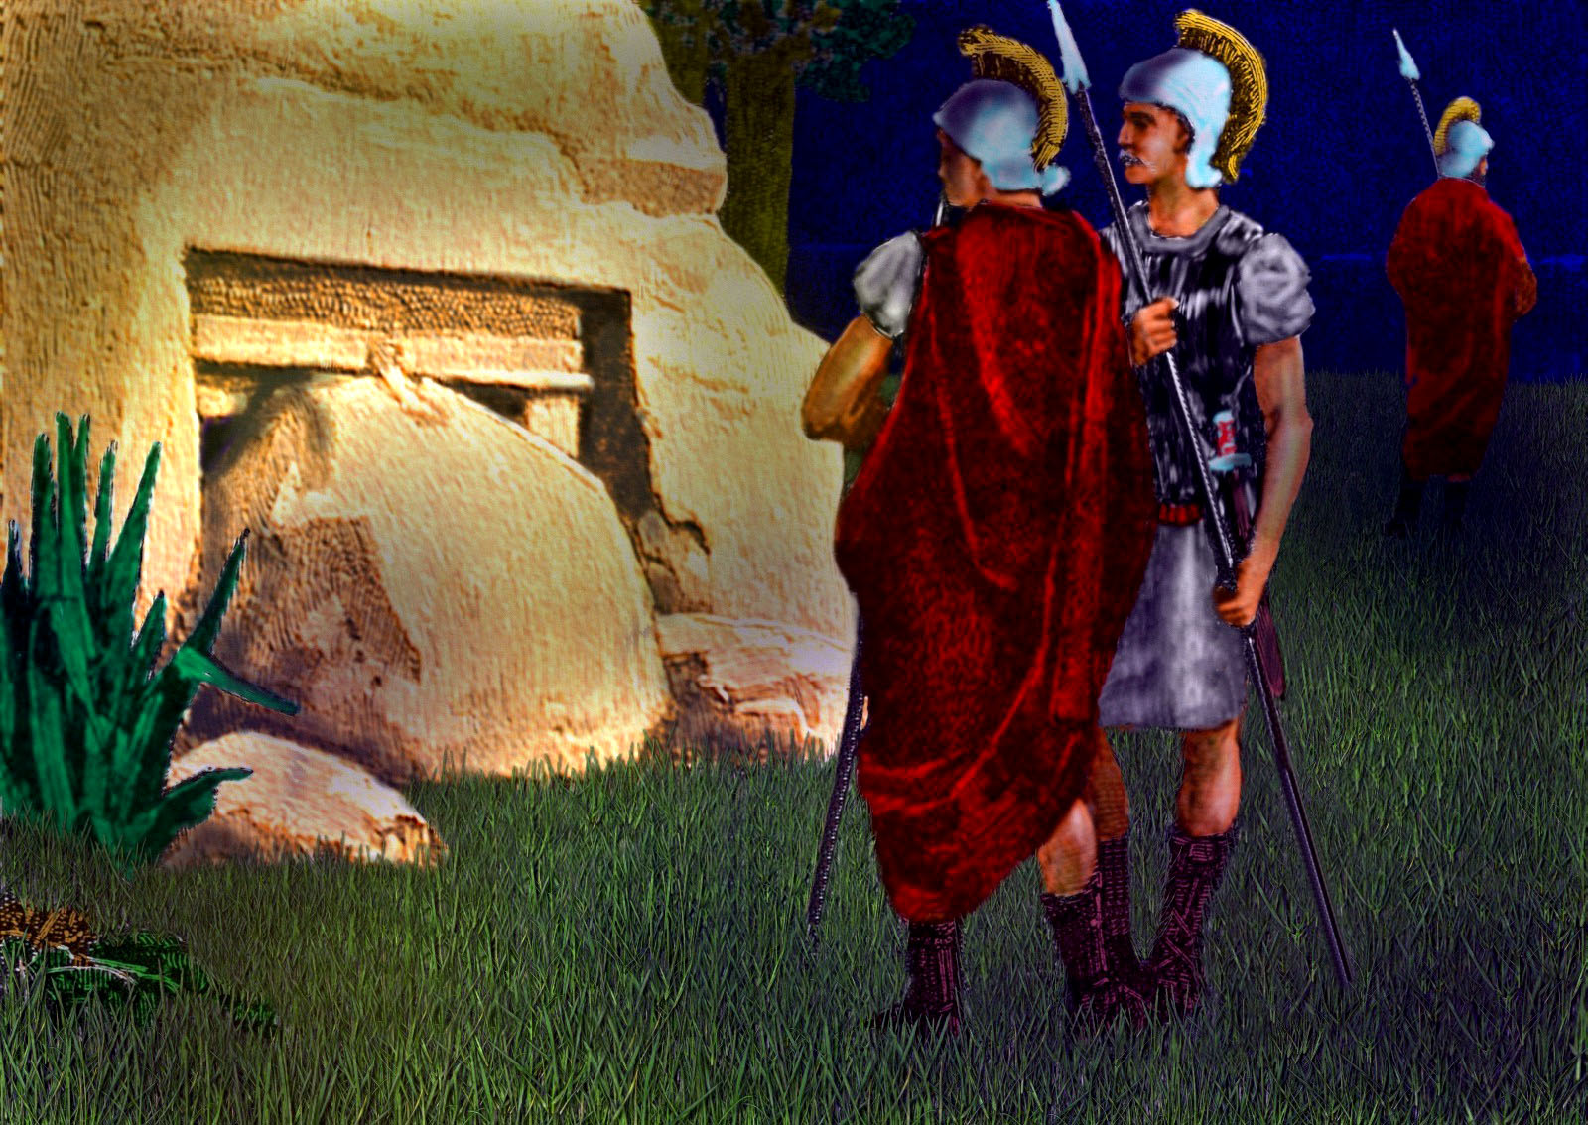
Mr. Leeper writes:
The sealing would have been accomplished by placing a large piece of clay at the joint of the stone and the wall. An official insignia of
some type would have been pressed into the soft clay leaving an imprint which could not be duplicated. The clay would then have hardened, providing a seal that would be broken if the stone were moved.

Slide 34
Sealing the tomb would serve a threefold purpose. First, there would be evidence if anyone moved the stone. This would prevent someone from removing the body and then claiming he had been raised. Second, it would provide a guard of Roman soldiers to ensure no one could tamper with the tomb. Third, because it was a criminal offense to break a Roman seal, it would serve as an effective deterrent to anyone inclined to steal the body. Getting caught in the attempt would mean time in prison if not worse (Wayne D. Leeper, Prelude to Glory, p. 171).

Slide 35
Lk. 23:56 Then they returned and prepared spices and fragrant oils. And they rested on the Sabbath according to the commandment.

